Slide 1
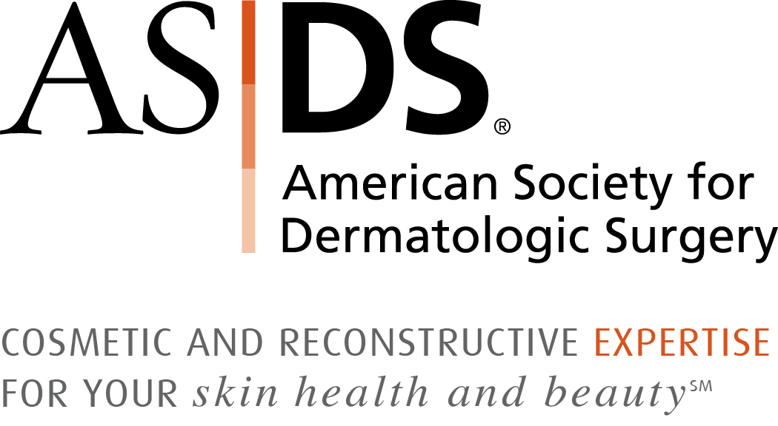
It is my pleasure to invite you to apply for membership in the American Society for Dermatologic Surgery (ASDS).
ASDS is the premier specialty group representing dermatologists performing all procedures.
ASDS members are experts in treating skin health and beauty through surgical and non-surgical methods.
asds.net
Follow @ASDSMembers

Slide 2
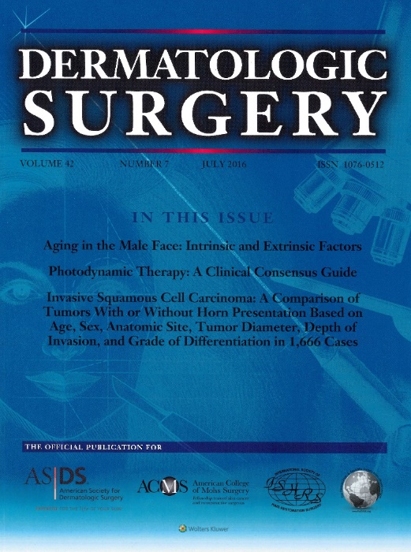
ASDS Membership Highlights:
Stand out as THE skin health and beauty expert internationally.
Enhance your skills with best-in-class educational programs.
Build an influential international professional network.
Access specialized resources to enhance your professional growth.
Free subscriptions to Dermatologic Surgery, Currents, ASDS Learn and ASDS Connect.
FREE with membership
asds.net
Follow @ASDSMembers

Slide 3
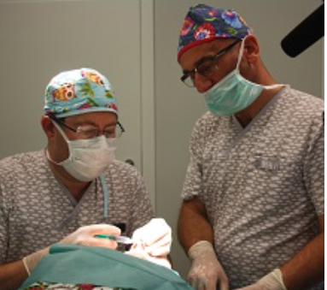
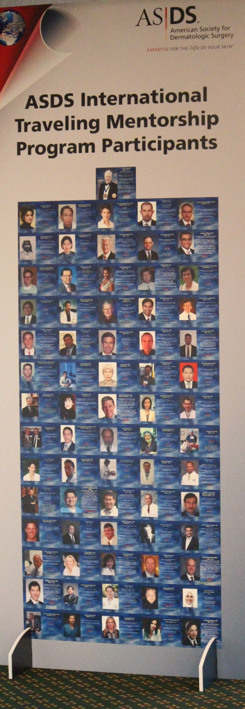
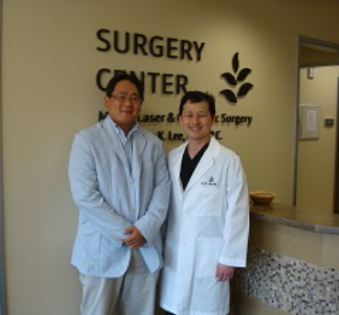
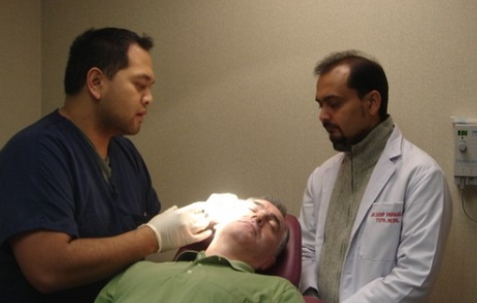
International Educational Exchanges
  International Traveling Mentorship Program
    Enhance training and patient care
    across the globe
    Over 185 hosts, mentors from 34 countries
  International Preceptorship Program
    Visit an ASDS member in the U.S.
    Expand skills and get practice management tips for success
asds.net
Follow @ASDSMembers

Slide 4
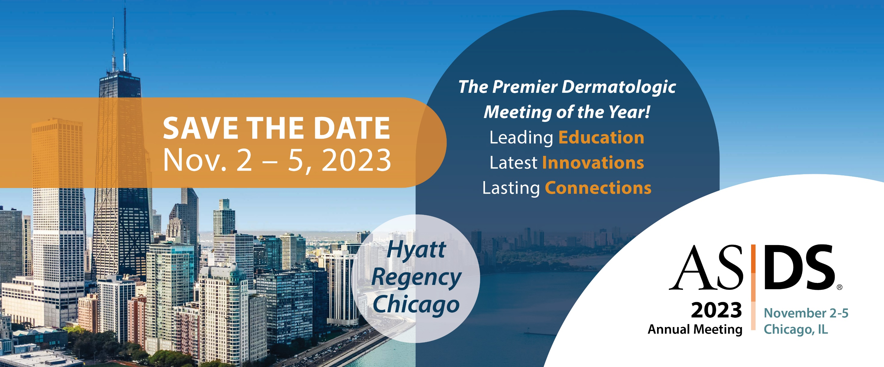
Follow @ASDSMembers
asds.net/annual-meeting

Slide 5

Join ASDS Today!
asds.net
Follow @ASDSMembers

