Slide 1

2018
ASDS Consumer Survey
on Cosmetic Dermatologic Procedures

Slide 2

Methodology
Developed by ASDS Survey Work Group
Online survey fielded by Survata May 1 to July 21, 2018
3,525 respondents
Survey split in four parts with some overlapping questions

Slide 3
ASDS MEMBER DERMATOLOGISTS
are the provider of choice for the 3rd year in a row!
    Patients
    10 of 10 categories
    Prospective Patients
    10 of 10 categories

Slide 4

What has the most INFLUENCE on having a PROCEDURE?
Top 3 of 14 factors influencing
the decision to have a procedure
51% DERMATOLOGIST
40% Friends
32% Primary care physicians

Slide 5

Physician of choice in 5 categories:
DERMATOLOGIST
1
Injectable wrinkle-relaxers
Varicose and spider vein treatments
Laser / light therapy for skin redness, tone and scars
Soft-tissue fillers
Laser hair removal*
2
3
4
5
*tie with another specialty

Slide 6
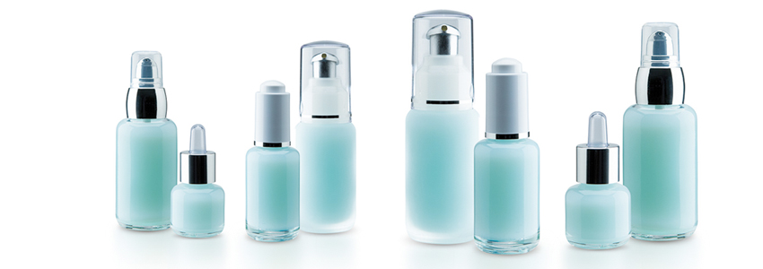
WHO has the most INFLUENCE on SKIN CARE purchases?
Top 4 of 14 factors influencing
the decision to have a procedure
50% DERMATOLOGIST
48% Friends
33% Primary care physicians
31% Relatives

Slide 7
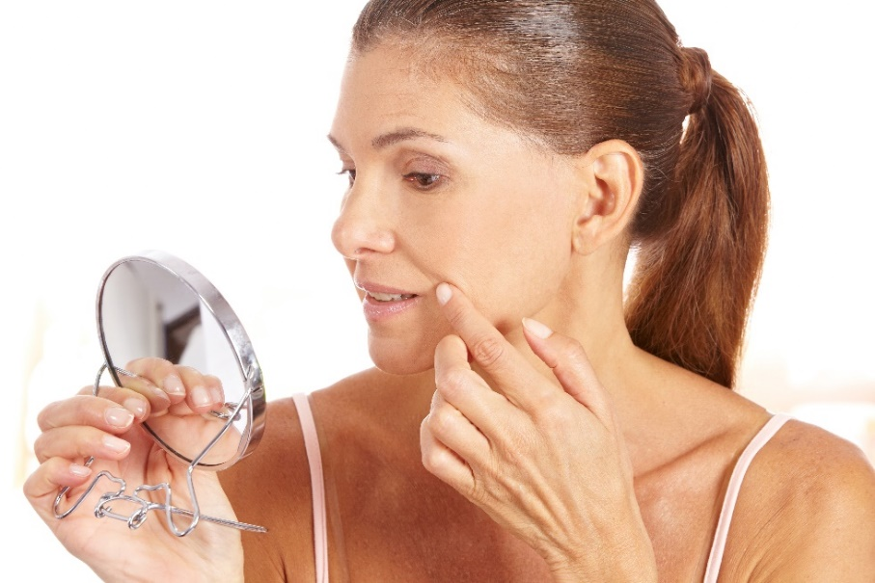
WHY are consumers exploring cosmetic procedures?
Top 3 reasons for 6 consecutive years!
I want to feel more confident.
I want to appear more attractive.
I want to look as young as I feel for my age.

Slide 8
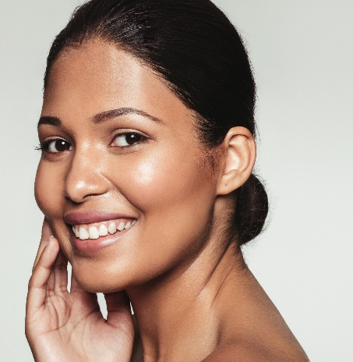
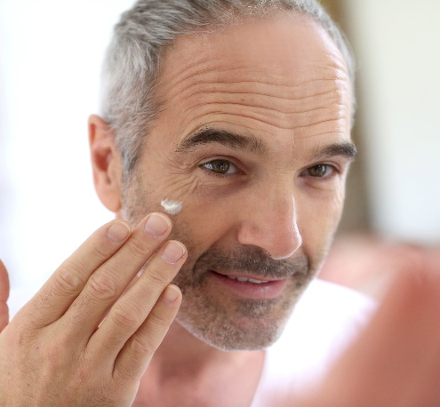
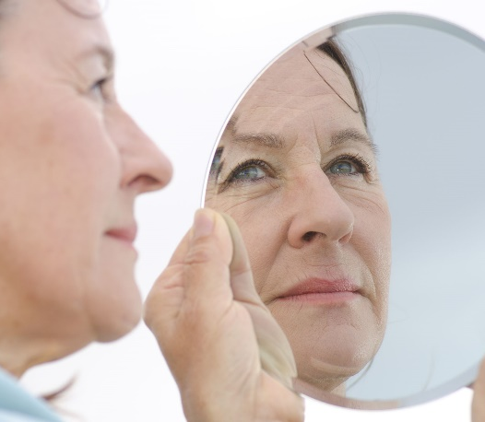
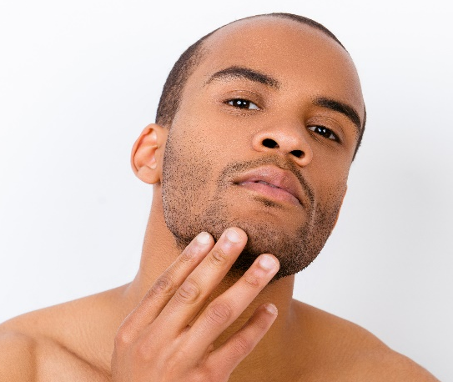

70%
ALMOST
of consumers are considering a
COSMETIC PROCEDURE

Slide 9
Consumers MOST bothered by…
Excess weight on any part of the body 86%
Excess fat under the chin / neck 73%
Skin texture and / or discoloration 73%
Lines and wrinkles around and under the eyes 72%
Skin discoloration increases as a concern, reinforcing the need for sun protection education.
Consumers LEAST bothered by…
Hair loss 57%
Acne scars 52%
Seborrheic keratoses (SK) 50%

Slide 10
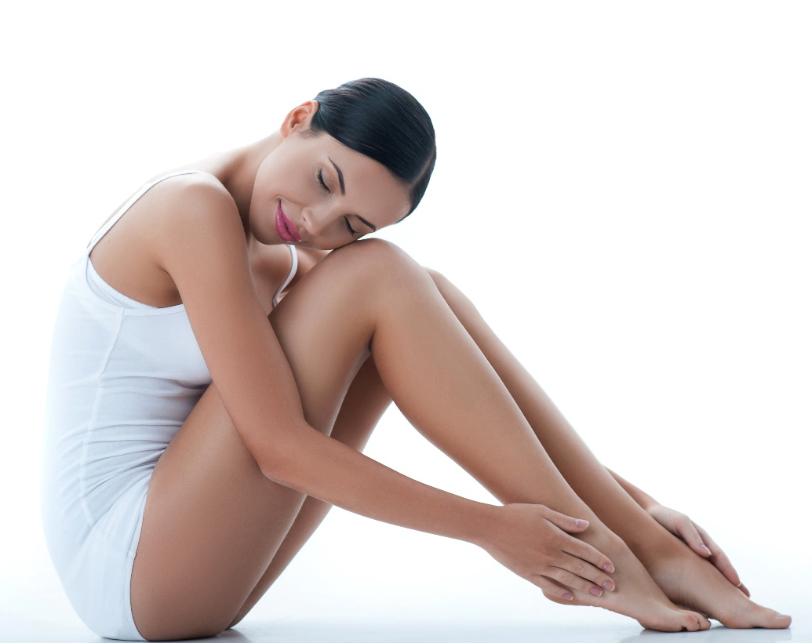
Top Procedures consumers are considering…
57% Ultrasound, laser, light and radiofrequency treatments for skin tightening and wrinkles
57% Body sculpting
51% Microdermabrasion
48% Laser hair removal
47% Injectable wrinkle-relaxers
5

Slide 11

Why are consumers WAITING?
Top 4 reasons
Cost
May be painful
May not get the results I’m looking for
Don't know what type of practitioner to see
© Copyright ASDS 2017.
Confidential: Do not distribute or disseminate.

Slide 12
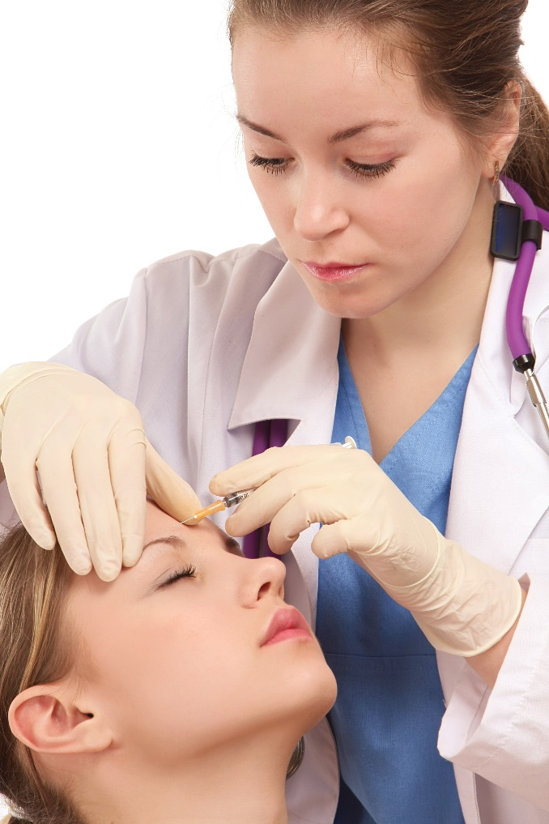
What has the most INFLUENCE on PRACTITIONER?
Top 3 of 11 factors influencing
the selection of a practitioner
49% Price
42% SPECIALTY in which the
physician is board-certified
37% Referral from a physician

Slide 13

Top SATISFACTION ratings*
Injectable wrinkle-relaxers and fillers
Body sculpting
Vein treatments
Chemical peels
Laser / light therapy for skin tone
Laser tattoo removal
*90% or higher

Slide 14

COST PER MONTH personal skin care products?
Top 3 price ranges for consumer spending on
skin care products per month.
55% $1 - $50
22% $51 - $100
9% $101 - $150
© Copyright ASDS 2017.
Confidential: Do not distribute or disseminate.

Slide 15

How do they PREFER TO PAY for skin care?
More than HALF OF CONSUMERS would prefer to pay more up front to lower their costs annually.
Paying more up front for cosmetic procedures can offset higher annual costs of skin care products.

Slide 16
Summary
Dermatologists are ranked as the No.1 influencer on the decision to have a cosmetic procedure and skin care decisions.
Specialty board-certification repeatedly ranked as top factor influencing the selection of a practitioner.
10 out of 10 patients and prospective patients would chose an ASDS member dermatologist.
Almost 70% of consumers are considering cosmetic procedures.
More than half of consumers would rather pay more up front for skin care needs, resulting in a lower cost annually.

