Slide 1
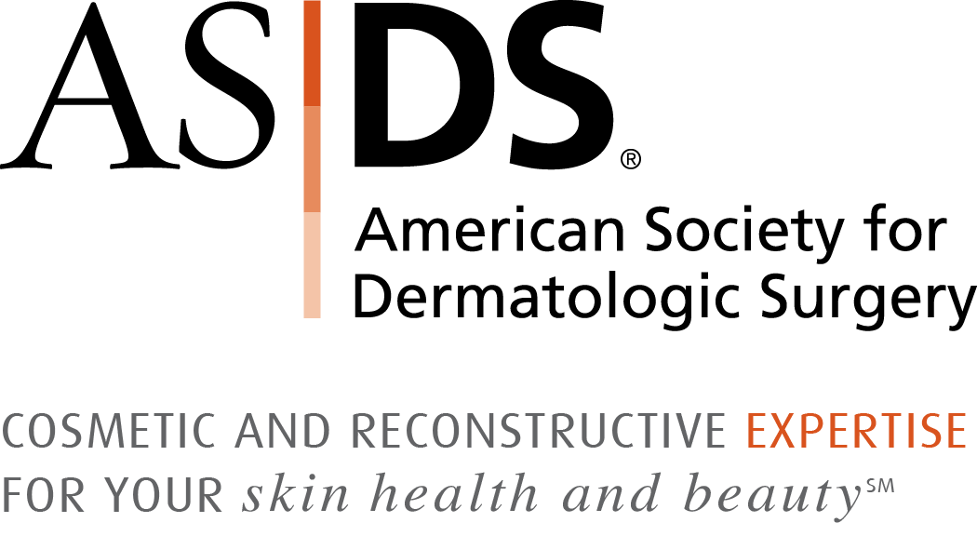
2017 ASDS Consumer Survey on Cosmetic Dermatologic Procedures

Slide 2
Methodology
Developed by ASDS Survey Work Group
Fielded on Survata April 14 to May 1
7,322 initial respondents
Qualifying question; respondents eliminated if they chose ‘would never consider a cosmetic procedure’
Field reduced to 4,558
Survey split in four parts; some overlap

Slide 3
Of 7,322 surveyed in 2017…
NEARLY
7
in 10
are considering a
COSMETIC
PROCEDURE
© Copyright ASDS 2017. Confidential: Do not distribute or disseminate.

Slide 4
Consumers MOST bothered by…
Excess weight on any part of the body 85%
Excess fat under the chin / neck 74%
Lines and wrinkles around and under the eyes 74%
Skin texture and / or discoloration 71%
Consumers LEAST bothered by…
Seborrheic keratoses (SK) 40%
Acne scars 41%
Hair loss 48%
© Copyright ASDS 2017. Confidential: Do not distribute or disseminate.

Slide 5
5
Top
procedures consumers are considering…
58% Body sculpting 57% Ultrasound, laser, light and radiofrequency
treatments for skin tightening and wrinkles
53% Microdermabrasion
47% Laser hair removal
46% Injectable wrinkle-relaxers
© Copyright ASDS 2017. Confidential: Do not distribute or disseminate.

Slide 6
WHY
are consumers turning to cosmetic procedures?
Top 3 reasons 5 years in a row!
I want to feel more confident
I want to look as young as I feel for my age
I want to appear more attractive
© Copyright ASDS 2017. Confidential: Do not distribute or disseminate.

Slide 7
WHY are consumers waiting?
Top 4 reasons
Cost
May be painful
May not get the results I’m looking for
Don't know what practitioner to see
© Copyright ASDS 2017. Confidential: Do not distribute or disseminate.

Slide 8
WHAT has the most influence?
Top 3 of 11 factors influencing the selection of a practitioner
49% Price
41% SPECIALTY in which the physician is board-certified
37% Referral from a physician
© Copyright ASDS 2017. Confidential: Do not distribute or disseminate.

Slide 9
WHAT has the most influence?
Top 3 of 14 factors influencing the decision to have a procedure
50% DERMATOLOGIST
40% Friends
34% Primary care physicians
© Copyright ASDS 2017. Confidential: Do not distribute or disseminate.

Slide 10
Top SATISFACTION ratings*
Injectable wrinkle-relaxers and fillers
Microdermabrasion
Vein treatments
Chemical peels
Laser / light for skin tone
Laser / light for skin tightening
Laser tattoo removal
*90% or higher
© Copyright ASDS 2017. Confidential: Do not distribute or disseminate.

Slide 11
Physician of choice in 8 categories
DERMATOLOGIST
1
Injectable wrinkle-relaxers
Varicose and spider vein treatments
Laser / light therapy for skin redness, tone and scars
Soft-tissue fillers
Chemical peels
Ultrasound, laser, light and radiofrequency treatments for skin tightening and wrinkles
Laser hair removal*
Laser tattoo removal
2
3
4
5
6
7
8
*tie with another specialty
© Copyright ASDS 2017. Confidential: Do not distribute or disseminate.

Slide 12
Dermatologist of choice 2nd
year in a row
ASDS MEMBERS
Patients
10 of 10 categories
Prospective patients
10 of 10 categories
© Copyright ASDS 2017. Confidential: Do not distribute or disseminate.

Slide 13
Five Year Review
The percent of consumers considering a cosmetic medical procedures has doubled in the last five years.
Nearly 70% are considering a cosmetic treatment, up from 30% in 2013.
Dermatologists ranked as the No.1 influencer on the decision to have a cosmetic procedure each year.
Specialty board-certification repeatedly ranked as top factor influencing the selection of a practitioner.

Slide 14
2017 ASDS Consumer Survey on Cosmetic Dermatologic Procedures

